Slide 1
GUI Presentation: Flashcard WebApp
A Modern Tool for Effective Learning
Joshua Emmanuel • 5 May, 2025

Slide 2
Overview
A web-based flashcard application designed to help users:
Create digital flashcards effortlessly
Manage cards with intuitive tools
Study efficiently with interactive features
Digital flashcards for effective learning.

Slide 3

Key Features
Flashcard Management
Create, edit, and delete flashcards
Store questions/terms and answers/definitions
Organize by categories
Set difficulty levels (1-5)

Slide 4
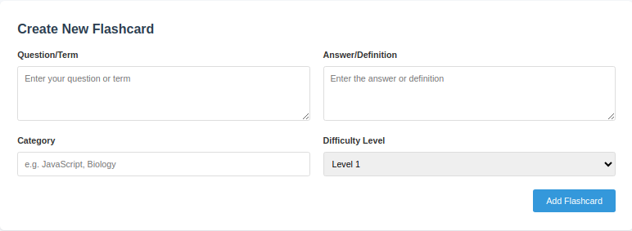
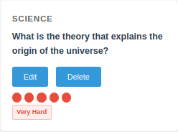
Flashcard Management
View of flashcard when created
Category
Question
Difficulty Selector
(1-5)
Default Level 1
Category Question Answer
Difficulty
Indicator
Delete
Edit

Slide 5
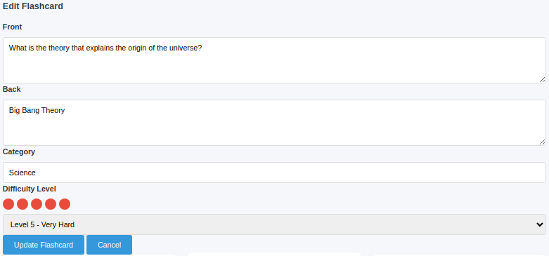
Flashcard Management
View of flashcard when editing
Edit Question
Edit Answer
Edit Category
Edit Difficulty
Click to apply Update

Slide 6
Key Features cont.
Study Mode
Interactive card flipping animation
Randomized card order
Navigation between cards
Category-specific study sessions
(including an All category)

Slide 7
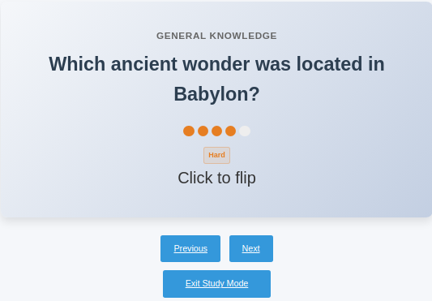
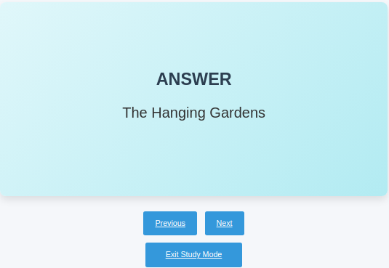
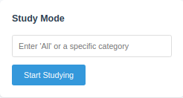
Study Mode
View of Study Mode
Study Mode Selector
All or Category Specific
Flashcard
Navigation
with
Exit Option
Front Display
with
Category
Question
Difficulty Indicator
Back Display
with
Answer

Slide 8
Key Features cont.
Search & Filter
Full-text search across all cards
Filter by specific categories
Pagination for large collections
(12 cards per page)

Slide 9
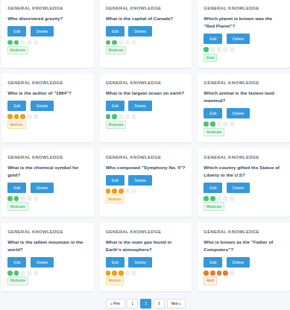
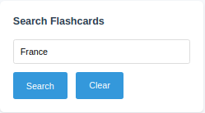
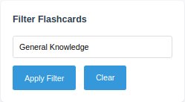
Search & Filter
Search & Filter Options
Display of
Flashcards
using
Search
or Filter
12 Flashcards
per page
Search by question of answer
Filter by All or Category Specific
If a Search or Filter is not active
No flashcard will be displayed
Once Search or Filter is
Cleared, display becomes hidden

Slide 10
Key Features cont.
User Experience
Responsive design
Visual difficulty indicators
Form validation
Error handling

Slide 11
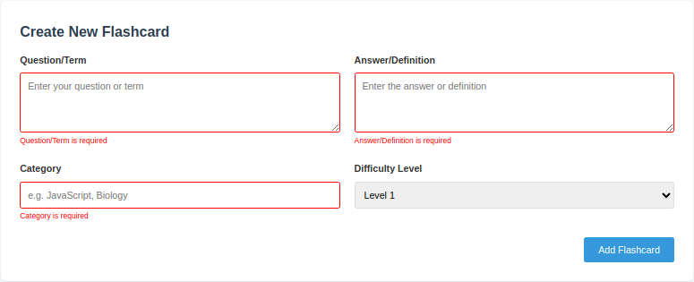





User Experience
Difficulty Indicator
Flashcard cannot be created if fields are empty

Slide 12
Technical Architecture

Slide 13
Backend
Node.js with Express framework
PostgreSQL database
Connecting pool for database efficiency
RESTful API design

Slide 14
Frontend
EJS templating design
CSS with modern layout techniques
Client-side interactivity
Responsive design principles

Slide 15
Key Dependencies
pg (PostgreSQL client)
dotenv (environment variable)
method-override (RESTful routes)

Slide 16
Database
Structure
id (primary key)
front (question/term)
back (answer/definition)
category
difficulty (1-5)
created_at/updated_at timestamps

Slide 17
Code Highlights

Slide 18
Validation
function validateFlashcardInput(front, back, category) {
const errors = [];
// Front validation if (!front || front.trim().length === 0) { errors.push("Question/Term is required"); }
// Back validation if (!back || back.trim().length === 0) { errors.push("Answer/Definition is required"); }
// Category validation if (!category || category.trim().length === 0) { errors.push("Category is required"); }
return errors; }
Random Card Selection
export const getFlashcardsForStudy = async (category = 'all') => { let query = "SELECT * FROM flashcards"; const params = [];
if (category !== 'all') { query += " WHERE category = $1"; params.push(category); } // Randomizes the order query += " ORDER BY RANDOM()";
const result = await pool.query(query, params); return result.rows;
};

Slide 19
UI Components

Slide 20
Flashcard Creation Form
Text area for Front & Back
Category input
Difficulty selector

Slide 21
Flashcard Display
Grid layout for browsing
Edit & Delete actions
Visual difficulty indicators

Slide 22
Study Mood Interface
3D flip animation
Navigation controls
Current position indicator

Slide 23
Conclusion
This flashcard application provides:
Simple yet effective learning tool
Clean, intuitive interface
Robust backend functionality
Easy customization and extension
Ideal for students, professionals, or anyone looking to implement active recall in their learning process.

